Slide 1
Rock Paper Scissors
Link to github Repository:
https://github.com/shannon-nz/pex
Links to trello board / project management tools: https://trello.com/invite/b/PftMeSlF/38189a196ae3729b0c1647bf8fc08002/rock-paper-scissors
You MUST provide evidence showing how the problem has been decomposed, how the components have been developed and trialled, and of how they have been assembled and tested to create a final, working outcome.

Slide 2
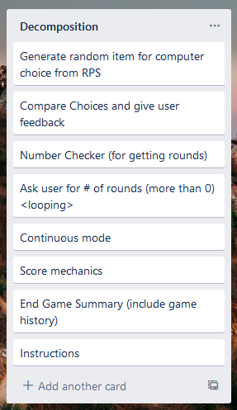
Decomposition
Notes:
Paste screenshots of your initial Trello board / task decomposition on this slide. If you have a long list, you might need to break it up into several columns. Delete this instruction when you are done.

Slide 3
1. Get User Choice Test Plan
Test Data | Expected
Rock | Accepted, changed to ‘rock’ (note lower case)
Paper | Accepted, changed to ‘paper’
Scissors | Accepted, stays as ‘scissors’
R | Accepted, changed to ‘rock’
P | Accepted, changed to ‘paper’
S | Accepted, changed to ‘scissors’
<enter> | Error message ‘please enter rock, paper, or scissors’
quit | Accepted, loop ends

Slide 4
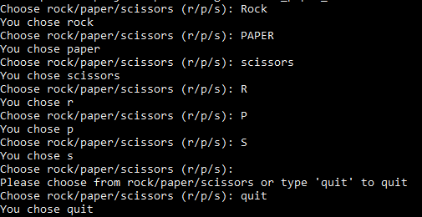
1. Get User Choice Testing
All tests passed

Slide 5
User Choice Trialling
Trial #1 (02_user_choice_v1) – checks user choice using four if / elif statements. Works for lowercase responses and returns full word (eg: ‘r’ returns ‘rock’
Trial #2 (02_user_choice_v2) – almost identical to trial #1 but error message can be customised (i.e. error message a parameter of the function)
Trial #3 (02_user_choice_v3) checks if response is in a given list (or is the first letter of an item in the list). Can be used for r/p/s or yes/no responses. Only works if first letter of options is different. Does allow users to use ‘x’ or ‘xxx’ as the exit code. I will use this function is assembled program.

Slide 6
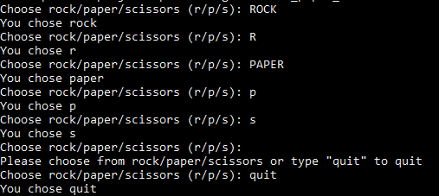

Slide 7
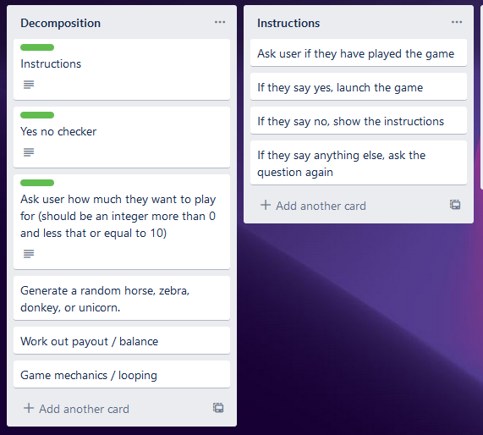
Get user choice

Slide 8
Component 1 - Test Plan (?and screenshot)
Test Case | Expected Values
Have you played before? Maybe Have you played before? Yes | <error> Please choose y / n Game Starts
Have you played before? No | Show instructions, then start game.

Slide 9
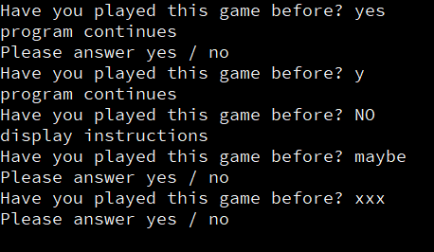
Yes / No Checker Test Plan
Test Data | Expected
Yes | Program continues
Y | Program continues
No | Program continues
N | Program continues
YeS | Program continues
Maybe | Please enter either “Yes” or “No”

Slide 10
Yes / No Checker Testing
All cases worked as expected (code has been looped to make testing easier)

Slide 11
Yes / No trialling
Intial Trial: The code worked for yes / no but failed if UPPERCASE characters were used. Trial 1 (01_yes_no_v1.py): This piece of code worked for both UPPER and lower case characters but was ineffecient. It has five if / elif / else statements and quite a bit of repeated code. Trial 2 (01_yes_no_v2): I used the ‘or’ command to combine my ‘yes’ / ‘y’ statements and this code is more efficient compared with trial #1. Trial 3 (02_yes_no_v1.py): I made the code from trial 3 into a function which makes it easy to ask more than one yes / no question in a program. I will use this function in my Lucky Unicorn outcome.

Slide 12
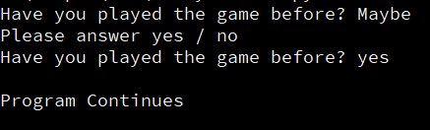
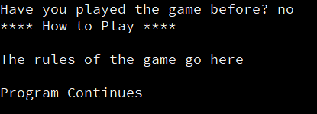
Instructions (and yes / no checker) Testing
Test Case 1 (maybe then ‘yes’) – output is as expected.
Test Case 1 (maybe then ‘yes’) – output is as expected.

Slide 13
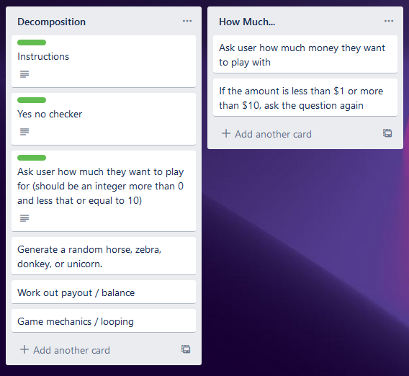
How Much? (Ask for user input)
The plan is to develop a number checking function as part of this component.

Slide 14
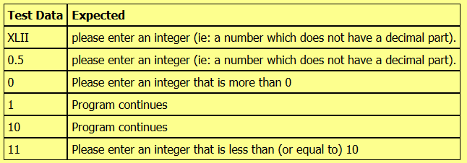
How Much? Test Plan

Slide 15
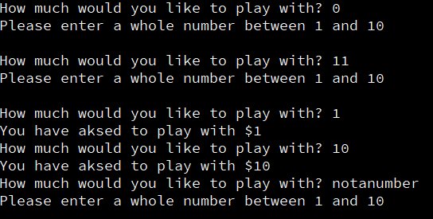
How Much? Checker Testing
All test passed. Program works correctly for unexpected, expected and boundary cases.

Slide 16
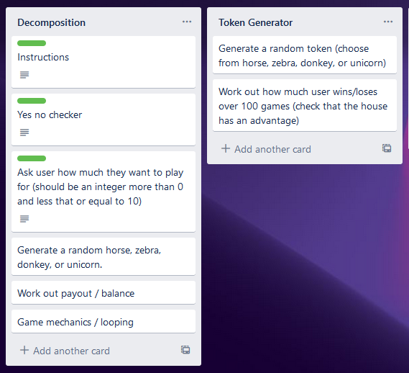
Token generator
The payout schedule is…
Donkey: lose $1.00
Horse / Zebra: lose $0.50
Unicorn: win $4.00 (i.e: If user starts with $1 and gets a unicornm their balance will be $5.00)
*In this component we need to check that over time the user loses money.

Slide 17

Token Generator Test Plan (Check tokens randomly generated)
Test Case | Expected values
Run the program | Program should output 20 tokens with at least one horse, donkey, zebra, and unicorn. Order of tokens should be random.
Results for 100 rounds, 10% chance of a unicorn, 30% chance for each of donkey, zebra, and horse.
Trial #2 (see trialling slide for details)

Slide 18

Token Generator Test Plan (Check house has an advantage)
Test Case | Expected values
User starts with $100. Run program | User should lose money (final balance should be less than $100)

Slide 19
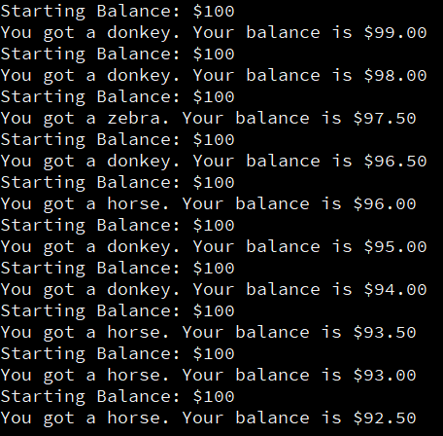

Token Generator Testing
Testing on the right only shows 10 rounds where the chance of a unicorn is 5%, chance of a donkey is 30% and the chance of a horse / zebra is 65%. If we run the program for more than 100 rounds, the house advantage becomes more clear

Slide 20
Payout Trialling…
Trial #1 (05_token_generator_v2.py): This program chooses from a list of horses, unicorns, donkeys, and zebras. When run 100 times, it became clear that the house would lose money instead of making money =.
Trial #2 (05_token_generator_v3): The list was edited so that it had 1 unicorn, 3 donkeys, 3 zebras and 3 horses. This lead to the house having an advantage.
Trial #3 (05_token_generator_v4): Instead of choosing the items from a list, I chose a random integer between 1 and 100. The schedule was set up so that users have a 5% chance of getting a unicorn, a 30% chance of a donkey, and a 65% chance of getting a horse / zebra. In my ‘else’ statement, to decide between a horse and zebra, I set it up so that if the number that was generated was even, the token was a horse, otherwise it was a zebra.

Slide 21
Rounds Test Plan
For testing purposes, each round the user will lose $1.00 (i.e: they get a donkey each time)
Test Case | Expected Outcome
Starting amount: $5 Play until money runs out | Game should go for five rounds. Each round should be correctly numbered. After 5 rounds, ‘Sorry you have run out of money; should display
Starting amount: $5 Play 3 rounds | Game should go for three rounds. When user types ‘xxx’ (for round #4), game should end. Final balance should be $2

Slide 22
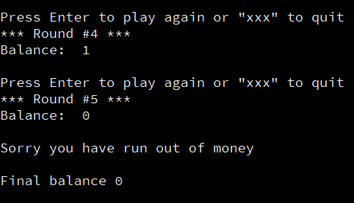

Rounds Testing
Exit code works correctly. I need to add a ‘thanks for playing’ message at the end of the game.
Ran out of money (game ended as expected)

Slide 23
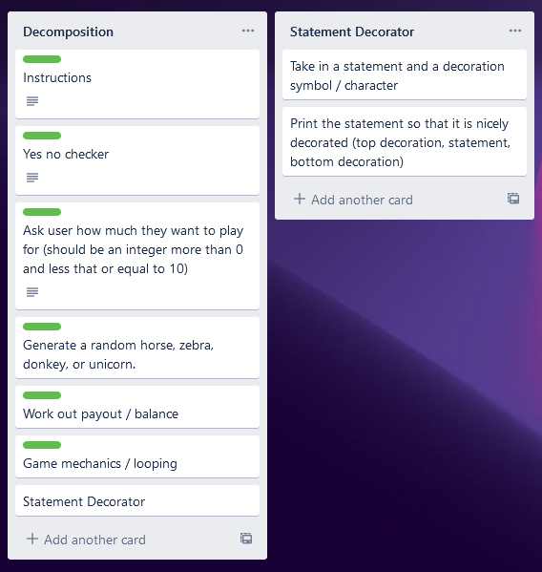
Statement Decorater
I realised that we often need to make output stand out and creating a function to help do this makes sense. This component was added to the decomposition near the end of the game development process.

Slide 24
Statement Decorator Test Plan
Test Case | Expected
Statement 1: Welcome to the Lucky Unicorn Game Decoration “*” Add some colour with colorama, only works when using the terminal. | ********************************************************Welcome to the Lucky Unicorn Game ********************************************************
Statement 2: Congratulations you got a Unicorn Decoration ”!” | !!!!!!!!!!!!!!!!!!!!!!!!!!!!!!!!!!!!!!!!!!!!!!!!!!!!!!!!!!!!!!!!!!!!!!!!!!!!!!!!!Congratulations you got a Unicorn !!!!!!!!!!!!!!!!!!!!!!!!!!!!!!!!!!!!!!!!!!!!!!!!!!!!!!!!!!!!!!!!!!!!!!!!!!!!!!!!!

Slide 25
Completed Game – Test Plan (part 1)
Test Case | Expected
Run Program Played Before? Maybe Instructions? Yes Amount? Xlii, 0.5, 0, 11, 1 Try above amounts to confirm number checker called correctly Play until money runs out | Welcome message displays Error – please type y/n Error for xlii, 0.5, 0, and 11 Random Token generated and score updated (most likely outcome is a single round game unless we get a unicorn) Stats show starting amount of 1 and balance of either $0.50 or $0.00

Slide 26
Completed Game – Test Plan (part 2)
Test Case | Expected
Run Program Instructions? n Amount? 10 Play untilbalance is $3.00 / $2.50, then press ‘xxx’ to quit | Welcome message displays Instructions are displayed Random Token generated each time user presses <enter> and balance is updated (lose $1 for donkeys, lose 50c for horse / zebra and gain $4.00 for unicorns). Balance should decrease over time Stats show starting amount of $10 and final balance of either $2.50 or $3.00

Slide 27
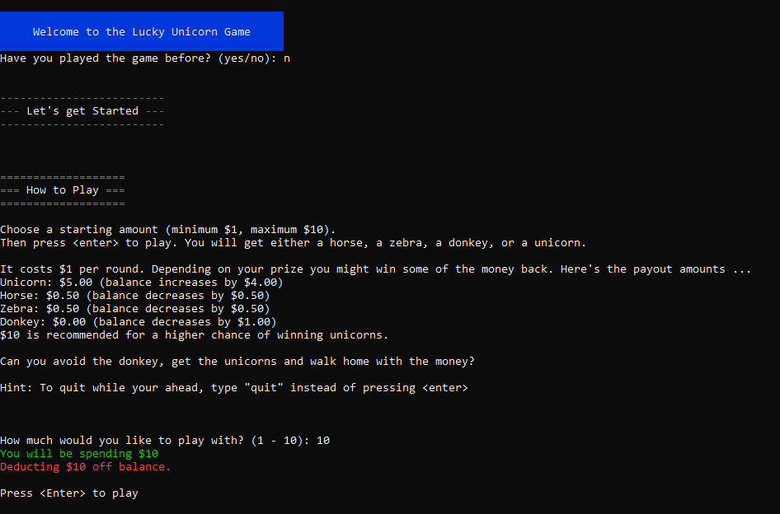
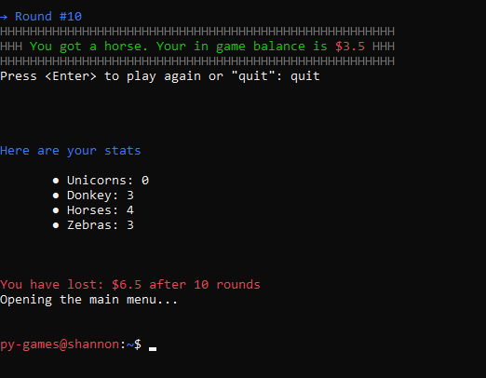
Completed Game – Test Plan (part 1)

Slide 28
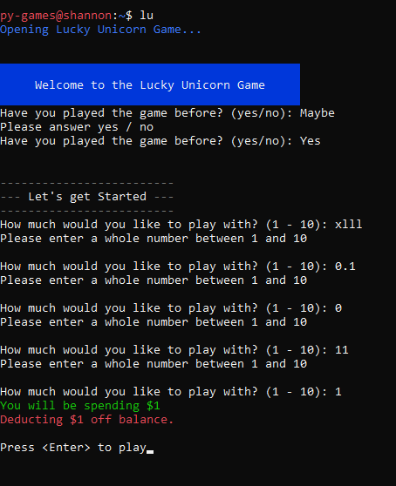
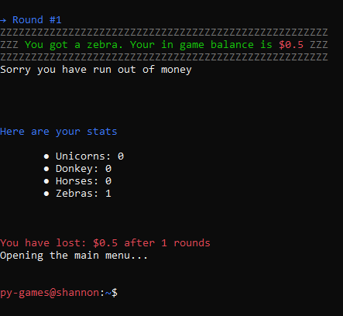
Completed Game – Testing (worked as expected)

Slide 29
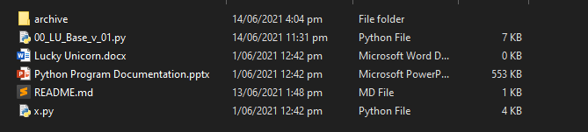
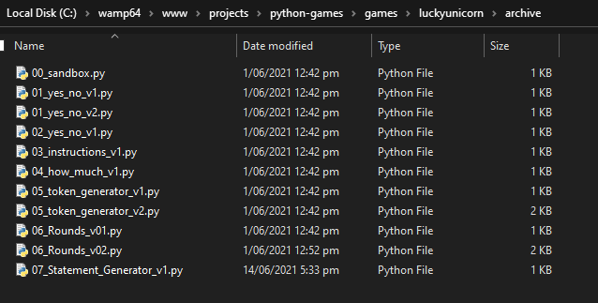
Version Control Evidence

Slide 30
Addressing Relevant Implications
I’ve comprehensively tested my outcome to ensure that the functionality implication has been address (i.e., it works for expected, unexpected, and boundary values).
The inclusion of optional instructions and clear error messages help to make the out come easy to use (i.e., addresses the Usability implication)
I’ve also carefully spaced the program’s output and used a statement generator function to address the aesthetics implication. Whilst aesthetics is not the main focus of text based programs, ensuring the outcome looks good also helps address the usability implication.

Slide 31
Addressing Relevant Implications
Finally, my program has a limit on the amount users can spend. This addreses the social implicayion as we have a gambling game but want toensure that users do not spend an excessive amount of money.

Slide 32
Trialling Slide
Copy this slide and edit the text to provide evidence of trialling components.

